Slide 1
openSUSE 11.3
suseROCKS (suserocks@bryen.com)
manugupt1 (manugupt1@gmail.com)

Slide 2
About the presenter
Introduce Yourself or a bit about yourself

Slide 3
Top Features
openSUSE is a stable release, and a good environment for developers to work in comfortably
More than 1000 desktop applications available
Netbook support using a live cd or using a USB disk
Support for Btrfs file system
Zypper with loads of improvement – like showing unneeded packages, improved package dependency handling and vendor changes to be notified.
LXDE for computers with minimal power

Slide 4
Exclusive openSUSE features
YaST2 – The most powerful installation and system management tool in Linux. Now with WebYaST for remote management.
openSUSE Build Service(OBS) - Develop, create and release open source software for multiple Linux distributions
SUSE Studio – Build a custom distro and add your own software and branding
Notes:
emphasize that openSUSE has a reputation for stability amongst major distros.
Also WebYaST is not included in the distribution

Slide 5
Find more packages via OBS
Install Software manually
Adding the Package Source
Zypper
Smart
Yum
APT
Notes:
The presenter should be well versed with the link
http://en.opensuse.org/Build_Service/User
a special tip! You can even use IRC to locate packages using !pin

Slide 6
Base system
Linux 2.6.34 which includes support for future Intel processors, improved virtualization and more energy saving features.
Alsa 1.0.23
Graphic Drivers
  X.org 7.5, xserver 1.8 packages
  Kernel Mode Settings enabled by default for ATI, Nvidia and Intel
  Nouveau is the default Nvidia driver
  Radeon has superseded radeonhd

Slide 7
Base system
Conntrack – network filtering system has been added
Upstart is included as optional init system
Grub2 is included for evaluation but not integrated

Slide 8
Tools to help in you in Development...
C, C++, Java, Mono C#, PHP, Perl, Python, Ruby, Scheme , Tcl all included in the DVD
Thousands of libraries to develop applications and scripts
Design highly scalable databases with MySQL, mariaDB, postgresql
GCC 4.5 with better link and whole-program optimizations, GDB 7.1 (GNU Debugger), Mono 2.6.4 etc
Emacs, Vim
Netbeans 6.8, QtCreator 1.3.1, Eric, Eclipse, Kdevelop
Doxygen, Tex Live System, LaTeX
Apache, Tomcat, MySQL server, Postgresql server

Slide 9
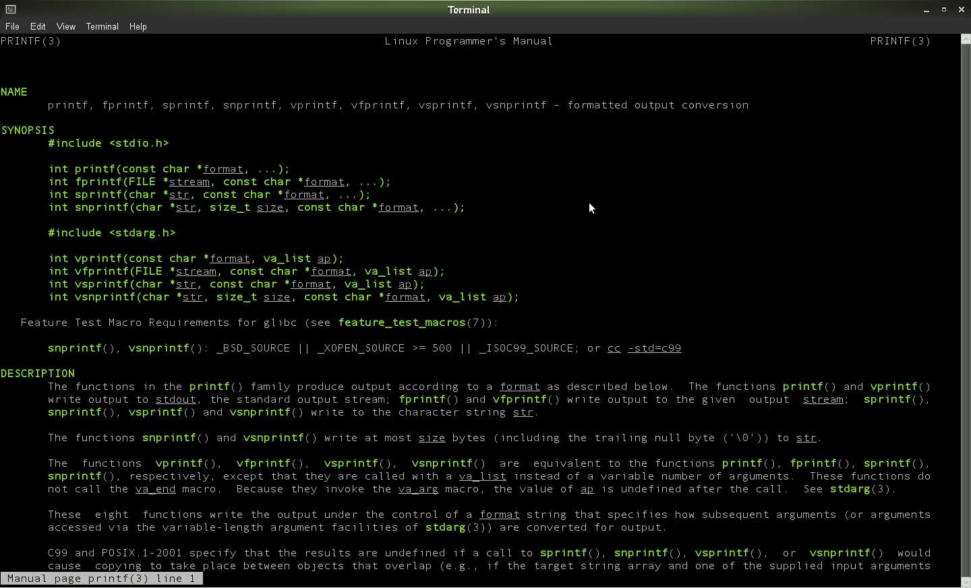

Slide 10
Applications
File syncing via spideroak(Present in Non OSS DVD)
Be productive with OpenOffice.org 3.2.1
Audio Editing with Rosegarden 10.04
Surf with Mozilla Firefox 3.6.6
Check mail with ThunderBird, Evolution and KMail.
Lots more applications are available at Contrib
  The universal openSUSE repository for third-party packages like GoogleCL.

Slide 11
GNOME
GNOME 3.0 preview is available with GNOME Shell and the new accessibility stack
Tracker - default file indexer, replacing beagle.
Empathy - default IM client for GNOME.
  Supports file drag and drop
  Supports IRC Command
Access iPhone/iPod Touch files via Nautilus and listen to music via Rhythmbox.
Transmission is now shipped with DHT enabled
Tomboy startup performance greatly improved. Tomboy now offers syncing option via preference option

Slide 12
GNOME
Nautilus’ user interface now includes a new split view mode and the default is set to browser mode.
Simple right-click menu item to open an archive file (zip, .tar.gz, etc.) in nautilus.
Improved selection of screensavers and games installed by default.
Complete move away from hal to udisks/upower.
Removal of the GNOME 1.x stack.
Major improvements to Banshee - the default media player
Comes with jhbuild for GNOME package building

Slide 13
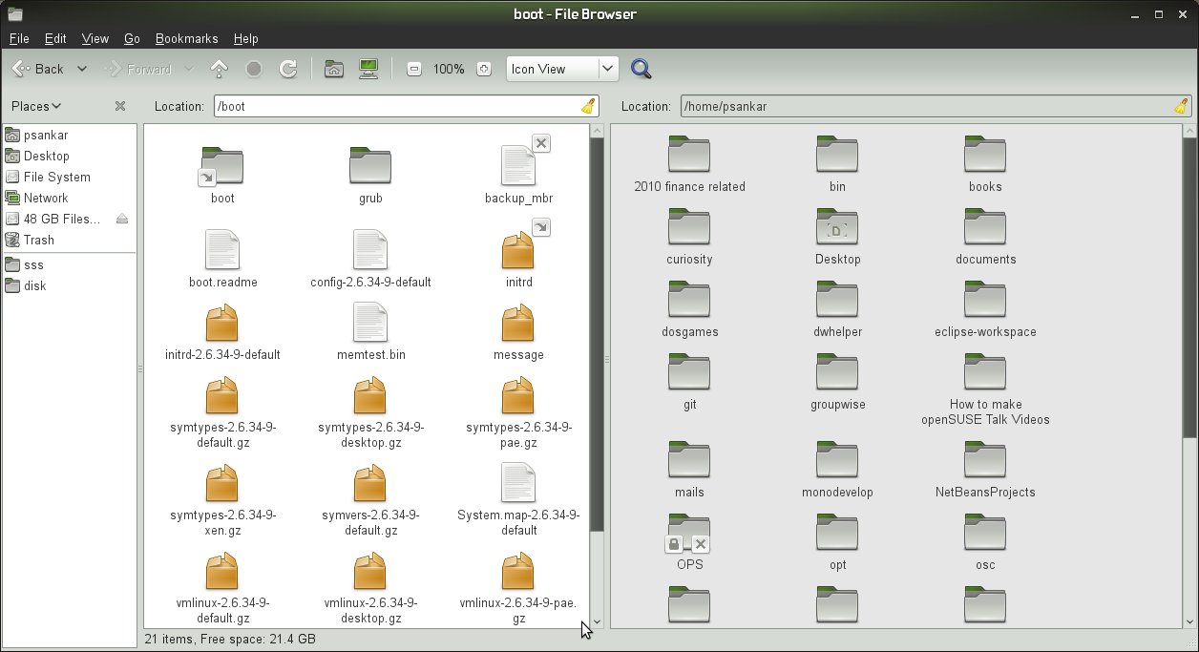

Slide 14
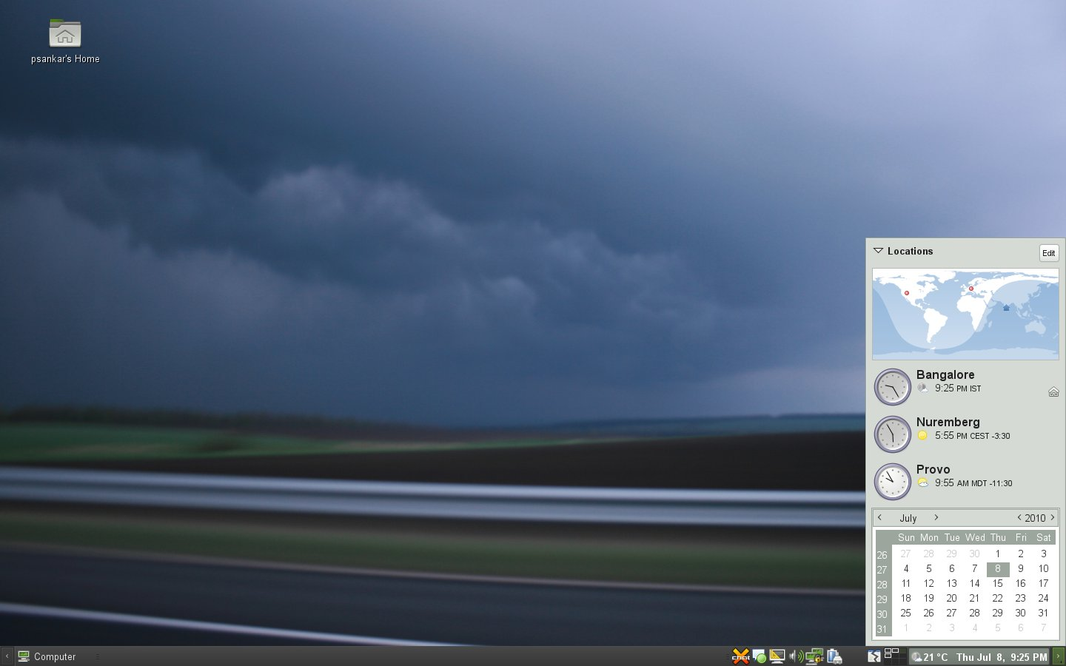

Slide 15
KDE
Synaptiks touchpad configuration tool is included
KTorrent is now shipped with DHT support now
KSuseInstall - on demand package installation, e.g. for Amarok codecs and debug packages
KUpdateapplet supports dist-upgrade
KAddressBook has been completely rewritten to use the new Akonadi PIM framework
Amarok is now at version 2.3
Develop KDE with Qt bindings
Use kde-buildsystem to build kde packages

Slide 16
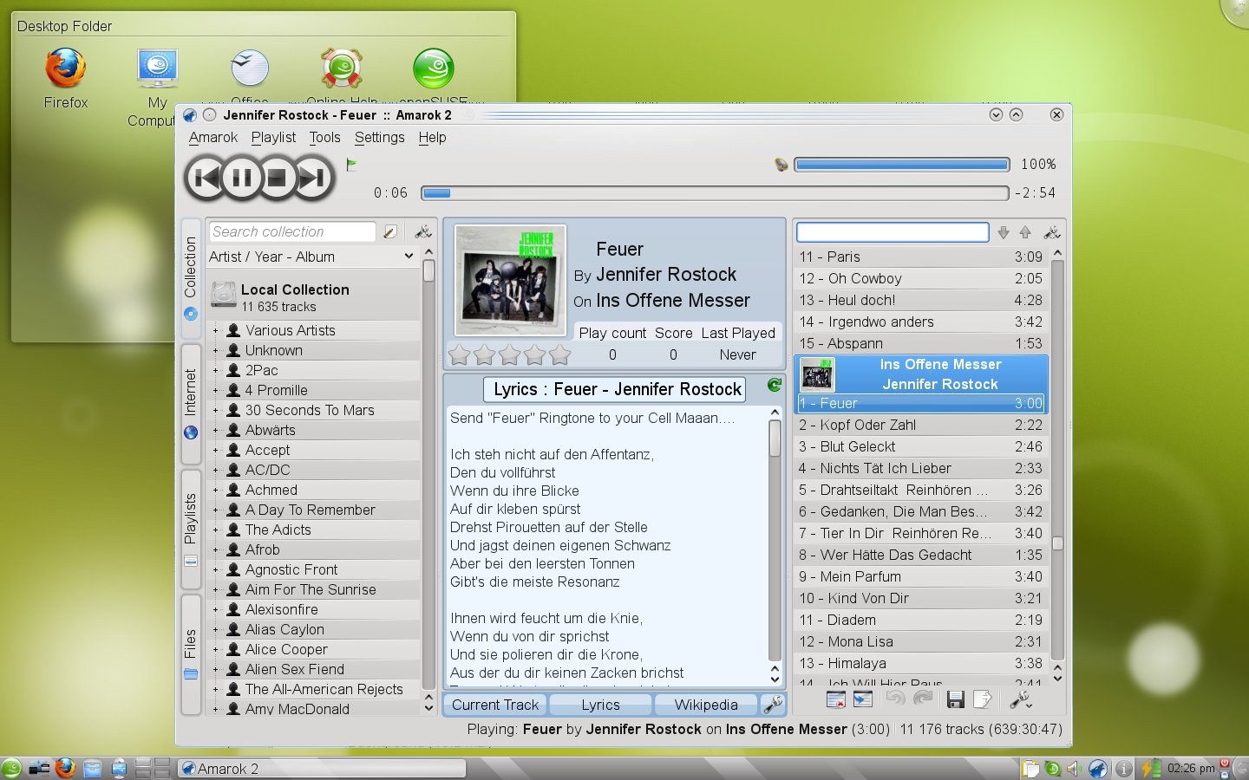

Slide 17
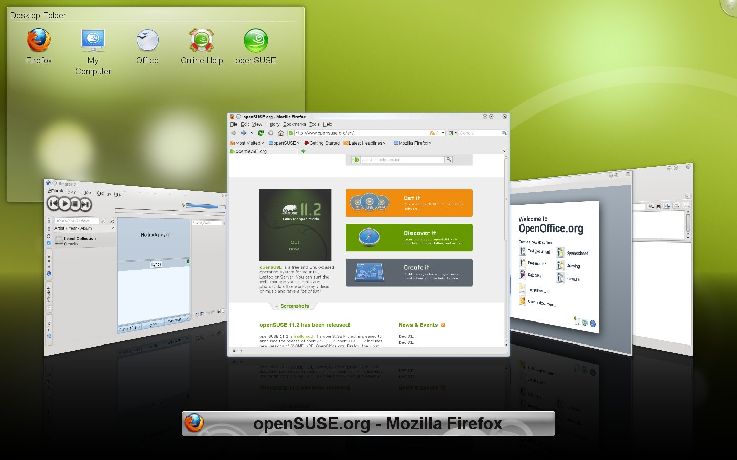

Slide 18
LXDE
Lxdm 0.2.0 as default Login Manager
Pcmanfm 0.9.7 completly rewritten with GVFS and Trash support
LXDE Control Center (LXCC) is included
Lxdm-conf configuration tool is included
Gnome-keyring support out of the box
Brasero as cd and dvd burning tool without any GNOME dependencies

Slide 19
More Desktop Changes
Xfce 4.6.1
Moblin UI

Slide 21
openSUSE Conference 2010
October 20th to 23rd 2010 in Nuernberg, Germany
Call for papers until 31st July
  http://en.opensuse.org/Conference_2010/Call_For_Papers
Details at http://en.opensuse.org/openSUSE:Conference

Slide 22
openSUSE Links
Follow @openSUSE on twitter and identi.ca
Download opensuse via http://software.opensuse.org
Learn more at http://www.opensuse.org

Slide 23
Any Questions???
Testing

Slide 24
Thank you
Testing

